Slide 1
Marin County
COVID-19 Update
School Leadership & Public Health Liaisons
January 4, 2022

Slide 2
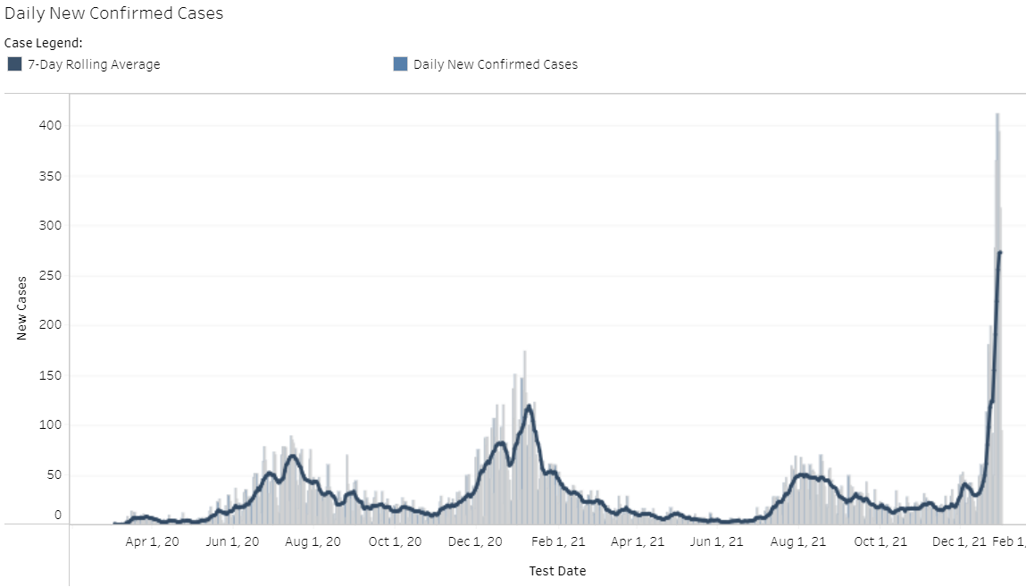
Marin County Daily COVID-19 Cases
December 28, 2021 – 412 Daily New Cases
Data accessed 1/3/2022

Slide 3
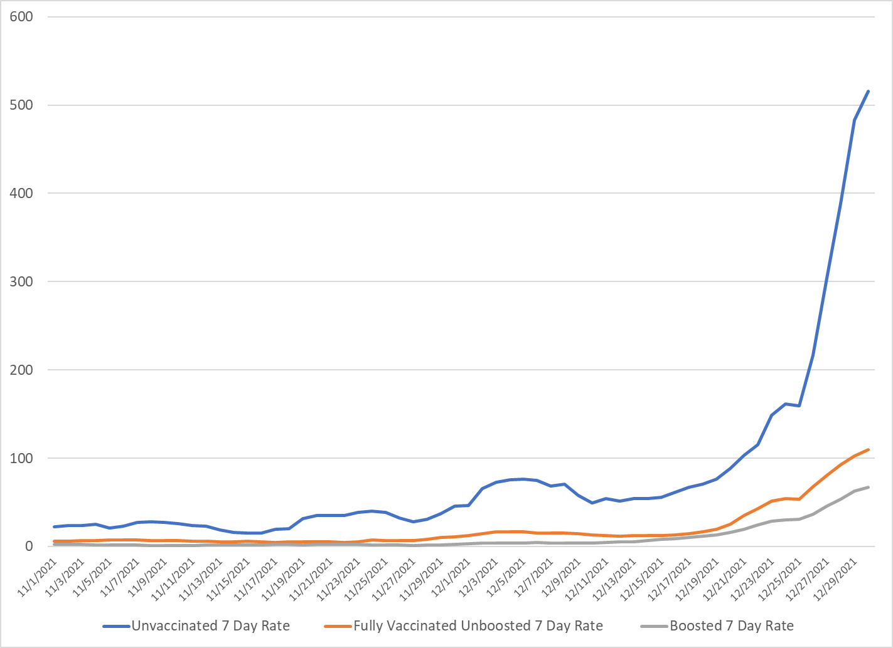
7-Day Average Case Rates by Vaccination Status Per 100,000
Data accessed 1/3/2022
Notes:
As of 8/30/21, only residents who have received no doses are included in the unvaccinated category and residents who are partially vaccinated, meaning they only received one dose of a two-dose vaccine or who are not yet 14 days after their final dose, are not included in either category.

Slide 4
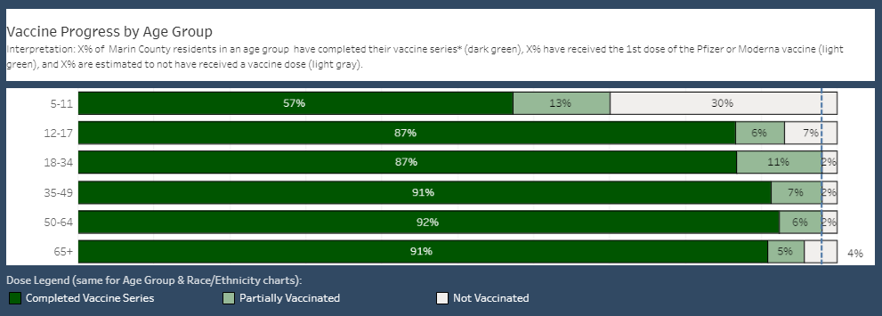
Vaccination Progress by Age
Data accessed 1/3/2022

Slide 5
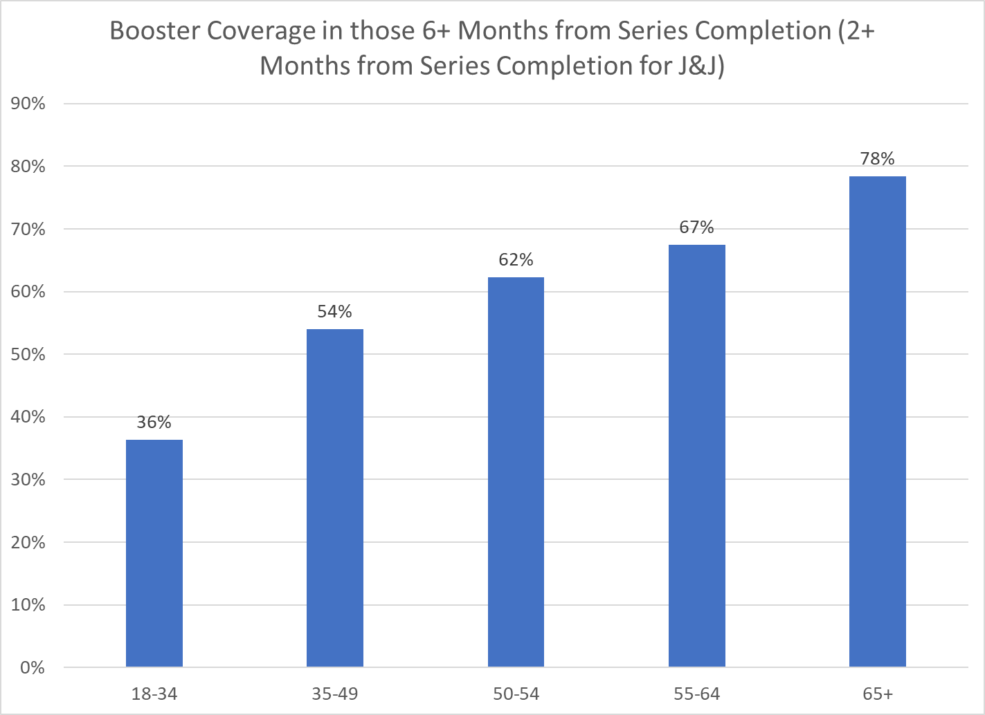
Booster Coverage by Age
Data accessed 1/3/2022
Notes:
Boosters in 65+ - 50%
75% by one month after for 5-11s

Slide 6
Case Rate by Vaccination Status
Vaccination Status as Dec 20, 2021 | Denominator Count | Omicron Case Count (Dec 20 - Dec 26, 2021) | Omicron Daily Case Rate Per 100,000 | RR Booster Protection
Boosted | 40501 | 48 | 16.93
Fully Vaccinated (Not Boosted) | 173753 | 502 | 41.27 | 2.44
Unvaccinated | 41864 | 247 | 84.29
Notes:
Don’t need to update

Slide 7
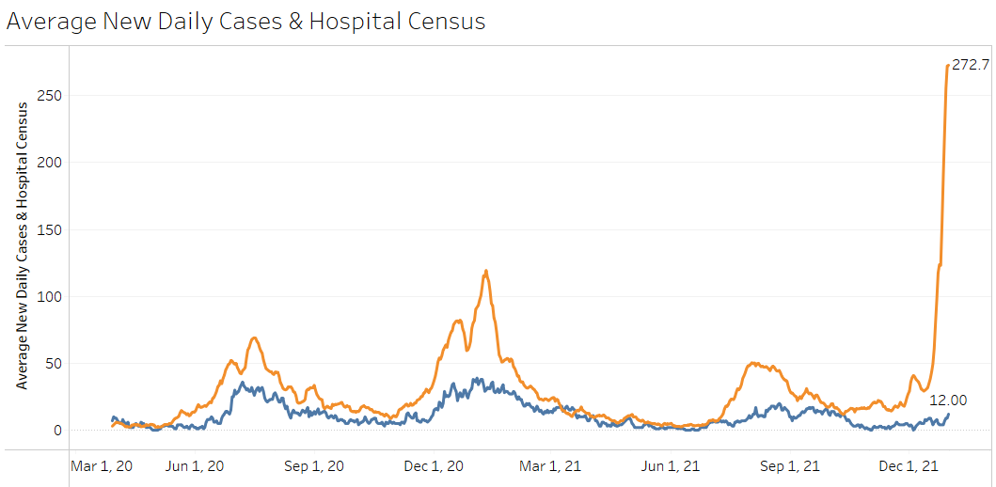
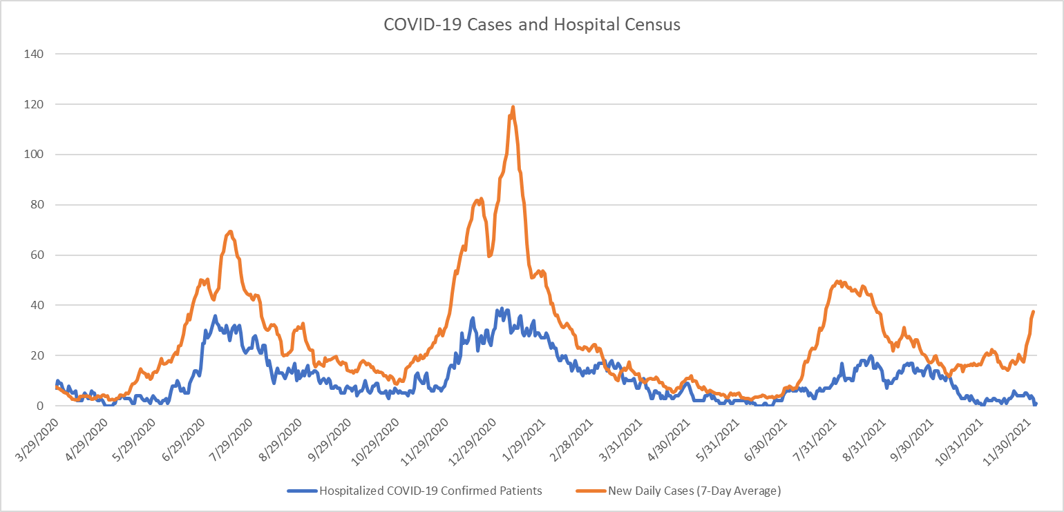
Case and Hospitalization Trends

Slide 8
Omicron Severity
United Kingdom:
  Hospitalization risk is 3 times lower than for Delta
  Among those hospitalized one in 15 require Intensive Care, compared to one in 5 with Delta
Physiology: Inflammation of upper airways, more than lungs

Slide 9
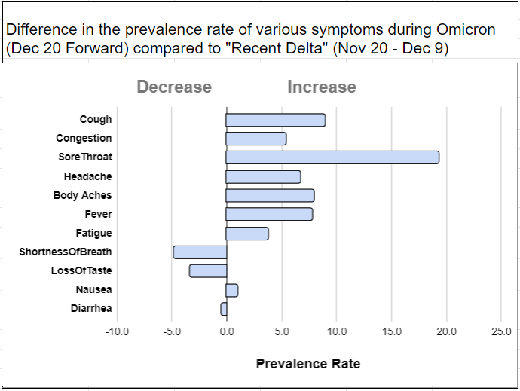
Marin County: Shift in Symptoms with Omicron
Sore throat was nearly 20% more prevalent among patients who tested positive during Omicron compared to patients who tested positive during “Recent Delta”.
Notes:
Among those with reported sx during Omi and Delta, this is the relative. Among people with Delta, x% experienced SOB and Y experienced SOB during Omi.

Slide 10
Preliminary Results of Return to School Testing
December 29-January 4
Primary.Health
  25,681 results
  649 positive
  2.5 percent positive

Slide 11

School Update

Slide 12
Percent Positive by Risk Behaviors: School Testing (Tests Reported Directly to MCDHHS)
% Positive by social activities | I didn't do this over the break | 1-2 times | 3+ times
Indoor Sports | 3.0% | 4.9% | 5.3%
Other Indoor With 10+ People Not in Household | 2.8% | 4.4% | 3.2%
Traveled Outside California | 2.9% | 5.5% | 4.8%
Indoor Contact with Travelers from Outside the Area | 2.9% | 4.0% | 4.6%
Unmasked Indoor Contact with Others from Outside Household | 2.8% | 3.5% | 3.3%

Slide 13
#8 COVID-19 K-12 School Testing Program
All schools should be enrolled in the California COVID-19 K-12 Schools Testing Program. Schools and districts will partner with Public Health to ensure equitable access to testing (including testing to exit isolation and quarantine and test to stay [TTS]).
Testing of students must include appropriate parental permissions obtained in advance.
If a vaccinated or unvaccinated student or staff member develops COVID-like symptoms or has close contact with someone confirmed with COVID-19, testing is recommended.

Slide 14
#9 Isolation and Quarantine Guidance
All schools should follow updated California Department of Public Health (CDPH) COVID-19 Public Health Guidance for K – 12 Schools.
Isolation can end after day 5 if fever free for > 24 hours without the use of fever-reducing medicine, symptoms resolving, and negative COVID test on day 5.
Marin County Public Health protocols, including modified quarantine and test to stay (TTS), should be followed (Isolation and Quarantine Guidance)

Slide 15
Isolation – COVID Positive Persons
Stay home (PDF) for at least 5 days after the date the test was taken (Day 0).
Isolation can end after day 5 if fever free for > 24 hours without the use of fever-reducing medicine, symptoms resolving, and negative COVID test on day 5.
  If test positive on day 5, may repeat on day 7.
  If negative on day 7, return to school; if positive on day 7, isolation can end after day 10. Return to school on day 11.
  Refer students/staff to health care providers for review of discordant test results and clearance to return

Slide 16
Quarantine – Exposed Persons
Unvaccinated and Vaccinated and booster-eligible but have not yet received their booster dose
  Stay home (PDF) for at least 5 days, after your last contact with a person who has COVID-19.
  Test on day 5; Quarantine can end after day 5 if symptoms are not present and negative COVID test on day 5 [if not testing, quarantine can end after day 10].
  Wear a well-fitting mask around others for 10 days,
  If test positive, follow isolation recommendations above.
  If symptoms develop, test and stay home.

Slide 17
Exposed Persons
Fully Vaccinated and boosted (if booster eligible) – No quarantine
  Test on day 5.
  Wear a well-fitting mask around others for 10 days.
  If test positive on day 5, follow isolation recommendations above.
  If symptoms develop, test and stay home.

Slide 18

#18 Gatherings
Large gatherings > 50 persons (i.e., school assemblies) are currently prohibited indoors and outdoors.

Slide 19
#24 Face Coverings
School staff should wear surgical-grade masks or higher-level PPE (e.g., KN95 or N95 respirator masks).
  For those wearing surgical masks, double masking, with a cloth face covering worn over the surgical mask, is recommended for enhanced protection.
  Masks are recommended at all times, including staff meetings
Masking should be worn outdoors when physical distancing is not feasible, except while eating or drinking.
Follow CDPH face covering guidance.

Slide 20
Final Updates
#29 Updated: Non-essential visitors, including parent volunteers will be limited. Essential workers will be required to adhere to all health and safety guidelines. Any substitutes, contractors, visitors or volunteers working directly with students should be vaccinated and boosted (if eligible).
#30 Updated: All eligible students and staff should get vaccinated or boosted (if eligible) as soon as possible and are required to verify their vaccination status. Staff that are not fully vaccinated are required to be tested weekly. Staff and student vaccination rate data (the percentage of staff and students who are fully vaccinated) should be published and posted on the school website and updated on a monthly basis. Vaccination status of individual students and staff will not be made public.
#31 Updated: Other School related youth activities (i.e., student transportation, sports, music, drama, after school care, etc.) will follow updated CDPH and Marin County Public Health guidance. Indoor sports games and practices should not allow spectators until further notice.

Slide 21
Parent Responsibilities
Students stay home when sick
Test or 10: COVID-19 testing required for symptomatic students
Parents must report positive test results to schools
Students who test positive for COVID-19 must isolate for at least 5 days
Unvaccinated household contacts / social close contacts must quarantine for at least 5 days

Slide 22
Summary
Mid-Omicron surge (expect peak mid-January)
  High case rates – hospitalization / death rates stable
Actively shifting to endemic circulation
  Harm reduction strategies
  Individual risk management
Updated I&Q guidance

Slide 23
Schools Team Updates
We are working on reporting positive tests from our county form directly to schools
Results from our county form will be sent by email on a daily basis
Schools can access their results from Primary.Health
Schools should determine student and staff return date using the Isolation and Quarantine Guide

Slide 24
Schools Team Updates
Please follow the instructions in the Positive Case Checklist when reporting a positive case
Schools will receive an email confirmation of a case submission, we may call with outbreak support based on reported cases
Decision to close schools will be based on school staffing, not reported cases.
Consult with your district administration regarding whole school closures

Slide 25
Schools Team Updates
Please consult the Isolation and Quarantine Guide before emailing or calling the Schools Team
We may not be able to answer emails/calls in a timely manner and will need to prioritize time sensitive inquiries and outbreaks
We are no longer able to review test results - a positive is a positive.
Please refer families to their health care provider for clearance to return if there are conflicting test results

Slide 26
Please bring policy questions to the weekly PHL meetings
Weekly Schools Team Office Hour TBD
QUESTIONS?? Thank you!

